Slide 1

Neurobiology of Trauma and Sexual assault

Slide 2

Definition of Trauma
The psychological response to an event when they:
Are experienced as physically or emotionally harmful or threatening
Have lasting adverse effects of the individual’s functioning and physical, social, emotional or spiritual well being.
Center for Social Justice and Non-Violence

Slide 3
Trauma is not an event, but a response to an event that overwhelms people physically and psychologically.
Dr. Peter Levine, Waking the Tiger, 1997

Slide 4
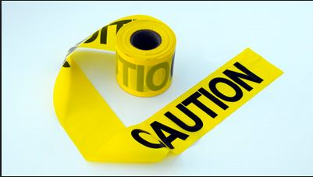
Traumatic Responses Can Alter…
Physiology
  Heart rate, respirations, dry mouth, knot in stomach, dilated pupils
Affective (mood and emotion) responses
  Fear, helplessness, horror
End Violence Against Women International

Slide 5

Traumatic Responses Can Alter…
Cognitive (thought) processing
  Memory – fragmented, out of sequence
  Time distortion
  Increased confabulation
  Trauma memory and recall
End Violence Against Women International

Slide 6
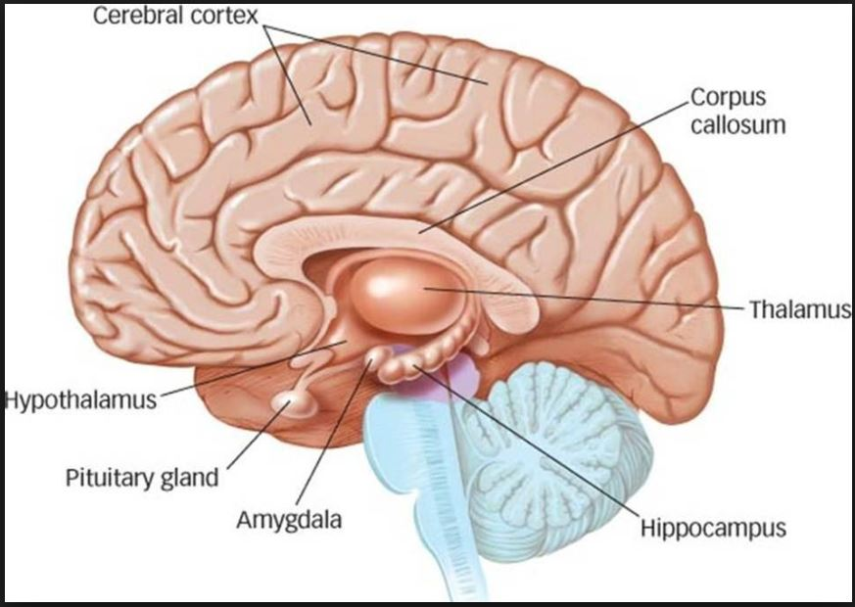

Slide 7
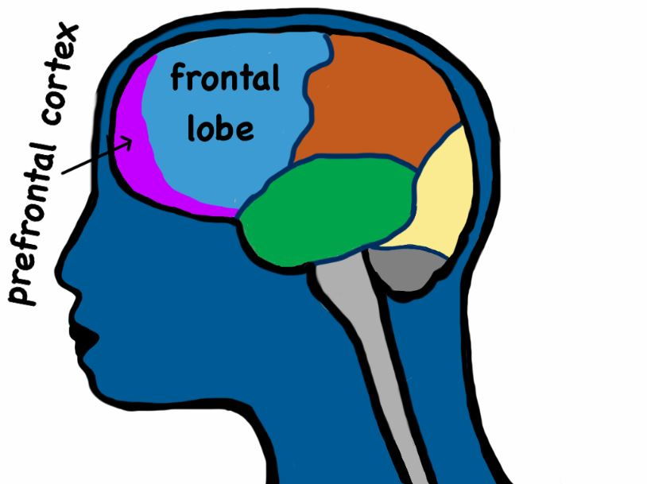
The Prefrontal Cortex
Plans a person’s response to complex and difficult problems
Acts as an “executive” for the decision making process.
Weaves past events to present experiences in order to make the best choices.
Jim Hopper, Exploring the Nature of Traumatic Memory

Slide 8
Key Functions of Prefrontal Cortex
Chooses where you focus attention and thoughts – reality testing
Holds thoughts, memories and other information so you can imagine alternatives
Inhibits habits and automatic responses, and inappropriate actions
Regulates emotions, how strong they are, how long they last, how you express them
End Violence Against Women International

Slide 9
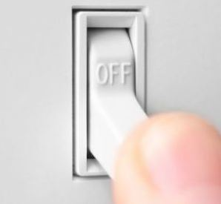
High Stress = Impaired
Prefrontal Cortex
Old and primitive brain structures take control
We cannot
  Control attention
  Think logically
  Over-ride emotions
  Hellooooooo amygdala!
End Violence Against Women International

Slide 10
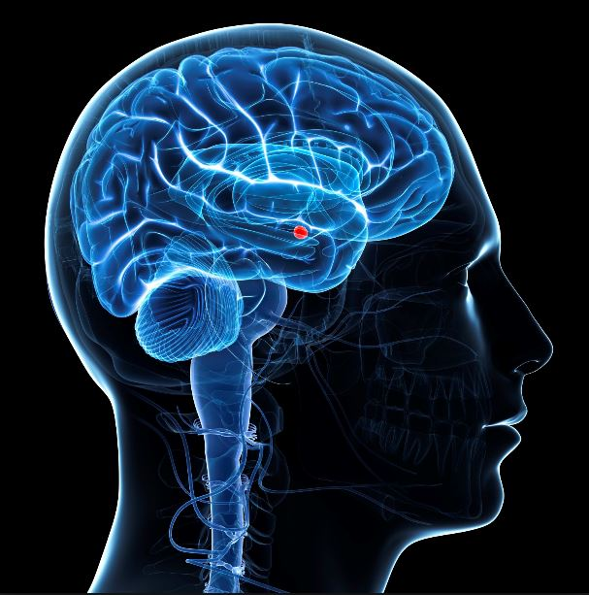
Memory
Amygdala:
Processes emotional reactions and memories
Signals Hypothalamus
HPA Axis kicks in
THREAT
Steven Southwick, MD, Yale University

Slide 11
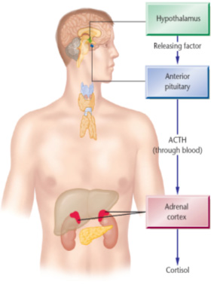
HPA-Axis is
responsible for
bringing the
body back into
balance

Slide 12
Hormones
Catecholamines: Fight/Flight/Freeze levels are increased; damage to memory, hyper vigilance & irrational thought (INCREASE)
Cortisol: Effects the energy available in your body to act
Opiods: Prevents pain. If levels increase, can result in flat affect, little emotion, no energy
Oxytocin: Promotes good feelings to counterbalance emotional or physical pain
Rebecca Campbell, Ph.D., Michigan State University

Slide 13
Amygdala Detects Threat
Activates Hypothalamus
HPA Axis Kicks in Hormonal Flood
Can trigger a Complete SHUT DOWN
Steven Southwick, MD, Yale University

Slide 14

Tonic Immobility
Uncontrollable mammalian response in extremely fearful situations
Paralysis, increased breathing
More common in victims with trauma history
Grace Galliano, Kennesaw State College

Slide 15
Memory Maker
Hippocampus: processes information into memories
  STEP ONE: Encoding = organizing sensory information
  STEP TWO: Consolidation = grouping information into memories and storing them
  Amygdala – Specializes in the processing of emotional memories (works with hippocampus)
Both structures are VERY sensitive to hormonal fluctuations
Rebecca Campbell, Ph.D., Michigan State University

Slide 16

How the Victim is Perceived
Inaccurate & Unreliable: Fragmented memories
Lying: “Inappropriate”
reactions
Crazy: Psychiatric symptomatology
FETI, Russell Strand

